Slide 1

Howard
Astronomical
League
13
February 21, 2013

Slide 2
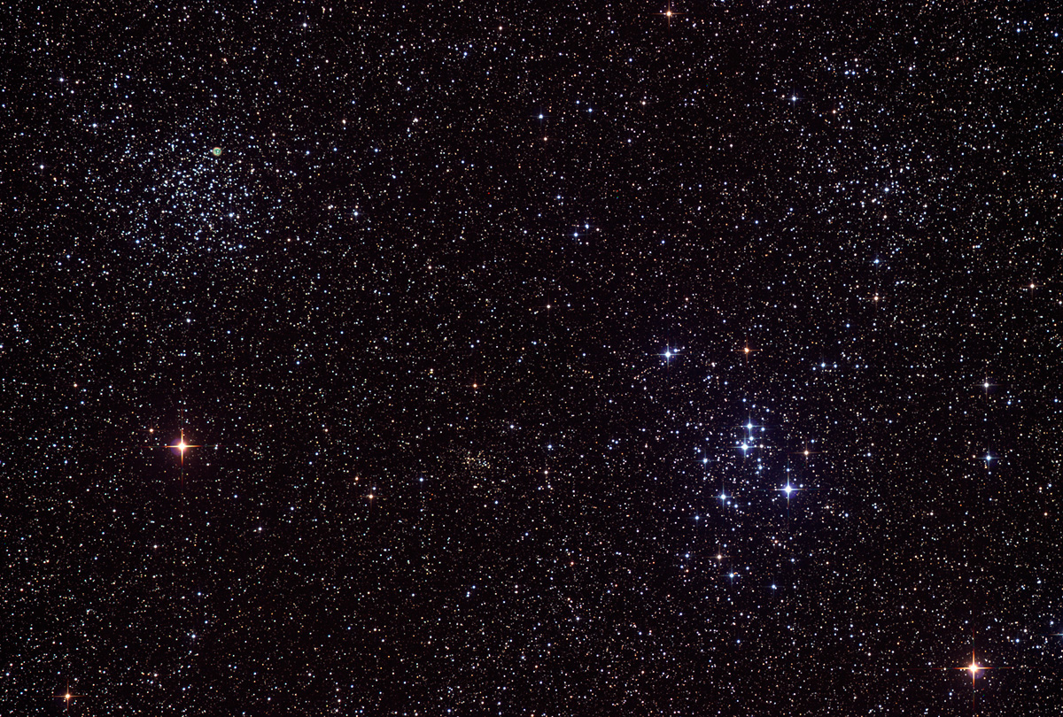
Club activities in March
Notes:
This will probably be the last time I present this meeting segment, since this information is going into an email to the Yahoo group, which goes to ~350 people, instead of the 35-50 people that attend the regular meeting.

Slide 3
Star Parties!
March 9th – Messier Marathon
(Member’s only)
March 16th – Public Star Party

Slide 4
Public Outreach
March 1st – Robinson Nature Center “First Friday”, 6-8pm
March 19th – Central Library, 7-9pm
March 26th – Savage Library, 7-8:30pm
Notes:
Robinson Nature Center for "First Friday", from 6-8 PM. We'll setup a few scopes on the "Green Roof", which is the terrace to the right of the entrance.
Savage Library is in Laurel, and if we’ve ever been there, it’s been quite a few years.

Slide 5
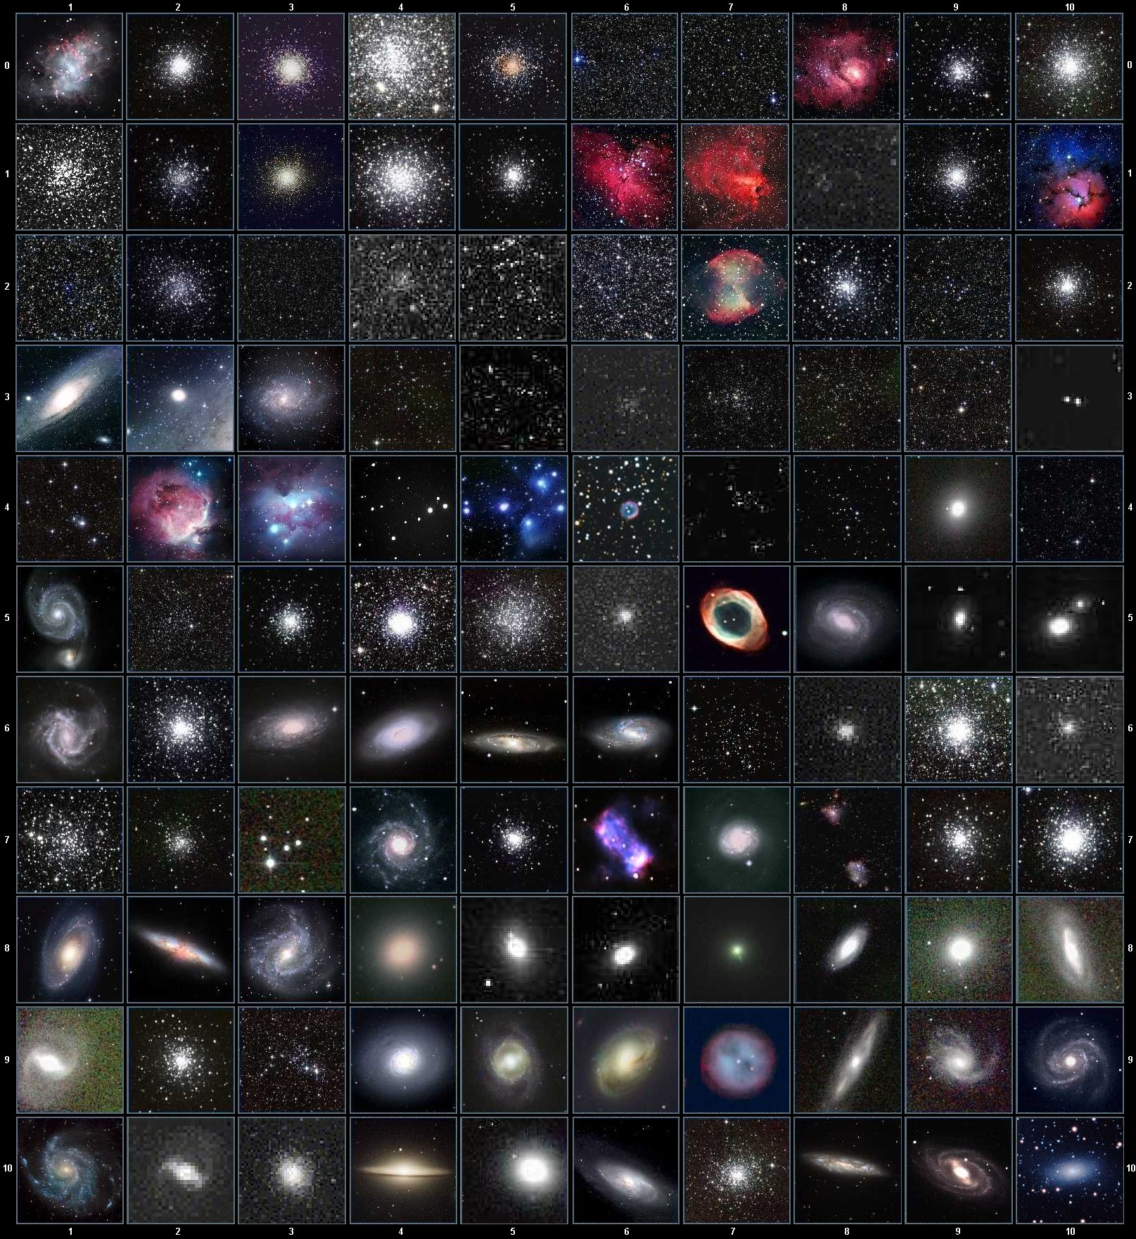
Messier Marathon
Notes:
“An informal competition to locate and observe the most Messier objects by a single observer during a dusk to dawn Marathon”.
The point is to hunt them down yourself, not use digital aids like digital setting circles or Goto scopes. While we will have prizes for the person that finds the most by star hopping, but this is a competition where everybody wins, because you’re going to see a lot of wonderful objects, and spend an all-nighter with your friends.

Slide 6
What is a Messier Marathon?
“An informal competition to locate and observe the most Messier objects by a single observer in a dusk to dawn Marathon.” – Amateur Astronomers of Pittsburgh
Notes:
competition to locate and observe the most Messier objects by a single observer during a dusk to dawn Marathon

Slide 7
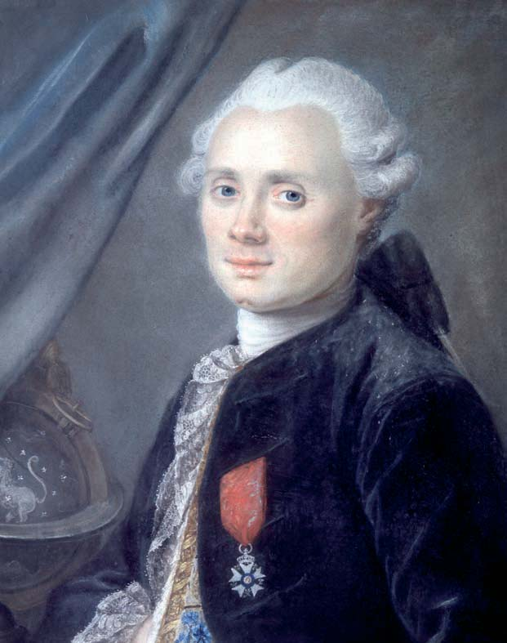
What are the Messier objects?
110 of the brightest and most beautiful objects in the Northern skies.
(That aren’t comets)
Notes:
competition to locate and observe the most Messier objects by a single observer during a dusk to dawn Marathon

Slide 8
Why do a Messier Marathon?
It’s fun!
You’ll see a lot of beautiful objects
Hangin out all night with your buds
Become more familiar with the sky
Become more familiar with your equipment
Become a better observer
Sense of accomplishment

Slide 9
Messier Marathon
Sunset 6:08 pm
Civil twilight 6:33 pm
Nautical twilight 7:04 pm
Astronomical twilight 7:36 pm
Moon rise (8.7%) 4:45 am
Astronomical twilight 4:59 am
Nautical twilight 5:30 am
Civil twilight 6:01 am
Sunrise 6:25 am

Slide 10
Messier Marathon
Sort objects by Right Ascension
(Move West to East and South to North)
Southerly objects set first, so observe them first
Anything with Declination > 50* is circumpolar and will be up all night
(11 objects)

Slide 11

Messier Marathon

Slide 12
What’s up this month?
Notes:
This will probably be the last time I present this meeting segment, since this information is going into an email to the Yahoo group, which goes to ~350 people, instead of the 35-50 people that attend the regular meeting.

Slide 13
What’s up this month?
Lemmon (C/2012 F6) – emerging from behind Sun in late March, could be mag 2 or 3 in April
PANSTARRS C/2011 L4 – early evening visibility should start around March 8th-12th, though it will move North all through March, steadily getting higher in the sky
Notes:
Lemmon (C/2012 F6) - Comet Lemmon is currently a Southern Hemisphere object, but should be emerging from behind the Sun in late March, and should be nicely visible to us in early April, possibly at mag 2 or 3. It's already mag 7, and giving off a strong green coma.
PanSTARRs is currently Diving towards the Sun, and should emerge the first week of March

Slide 14
What’s up this month?
Jupiter sets by midnight, but still worth a look in early evening
Saturn is rising at ~11 pm on 3/1, before 10 pm by end of month
Moon phases:
Last Quarter: March 4th, 4:51 PM
New: March 11th, 3:51 PM
First quarter: March 19th, 1:27 PM
Full: March 27th, 5:27 AM
Notes:
Lemmon (C/2012 F6) - Comet Lemmon is currently a Southern Hemisphere object, but should be emerging from behind the Sun in late March, and should be nicely visible to us in early April, possibly at mag 2 or 3. It's already mag 7, and giving off a strong green coma.
PanSTARRs is currently Diving towards the Sun, and should emerge the first week of March

Slide 15
Stumper Question

Slide 16
Which constellation has the greatest area?
Auriga
Gemini
Orion
Taurus

Slide 17
Best of the web
Notes:
I’m going to seriously trim down this segment by being far more selective. This month, only one thing worthy of mention here happened – the bolide over Russia. See if I can embed a video of that.

Slide 18
Member’s astrophotos and sketches

Slide 19
Comet ISON – 8” f/4 Reflector – SBIG 8300 CCD – 9 min each Jan 21, 2013 – Motion over 1h 10m Gene Handler

Slide 20
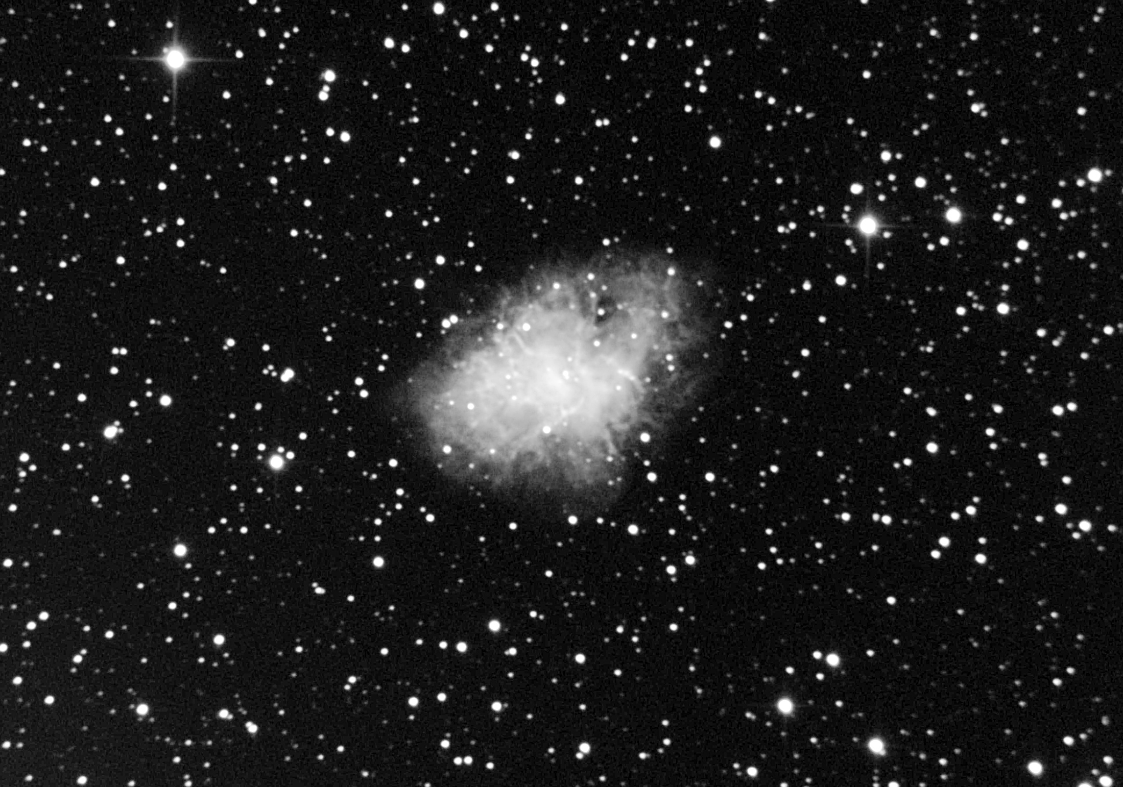
Gene Handler – Messier 1

Slide 21
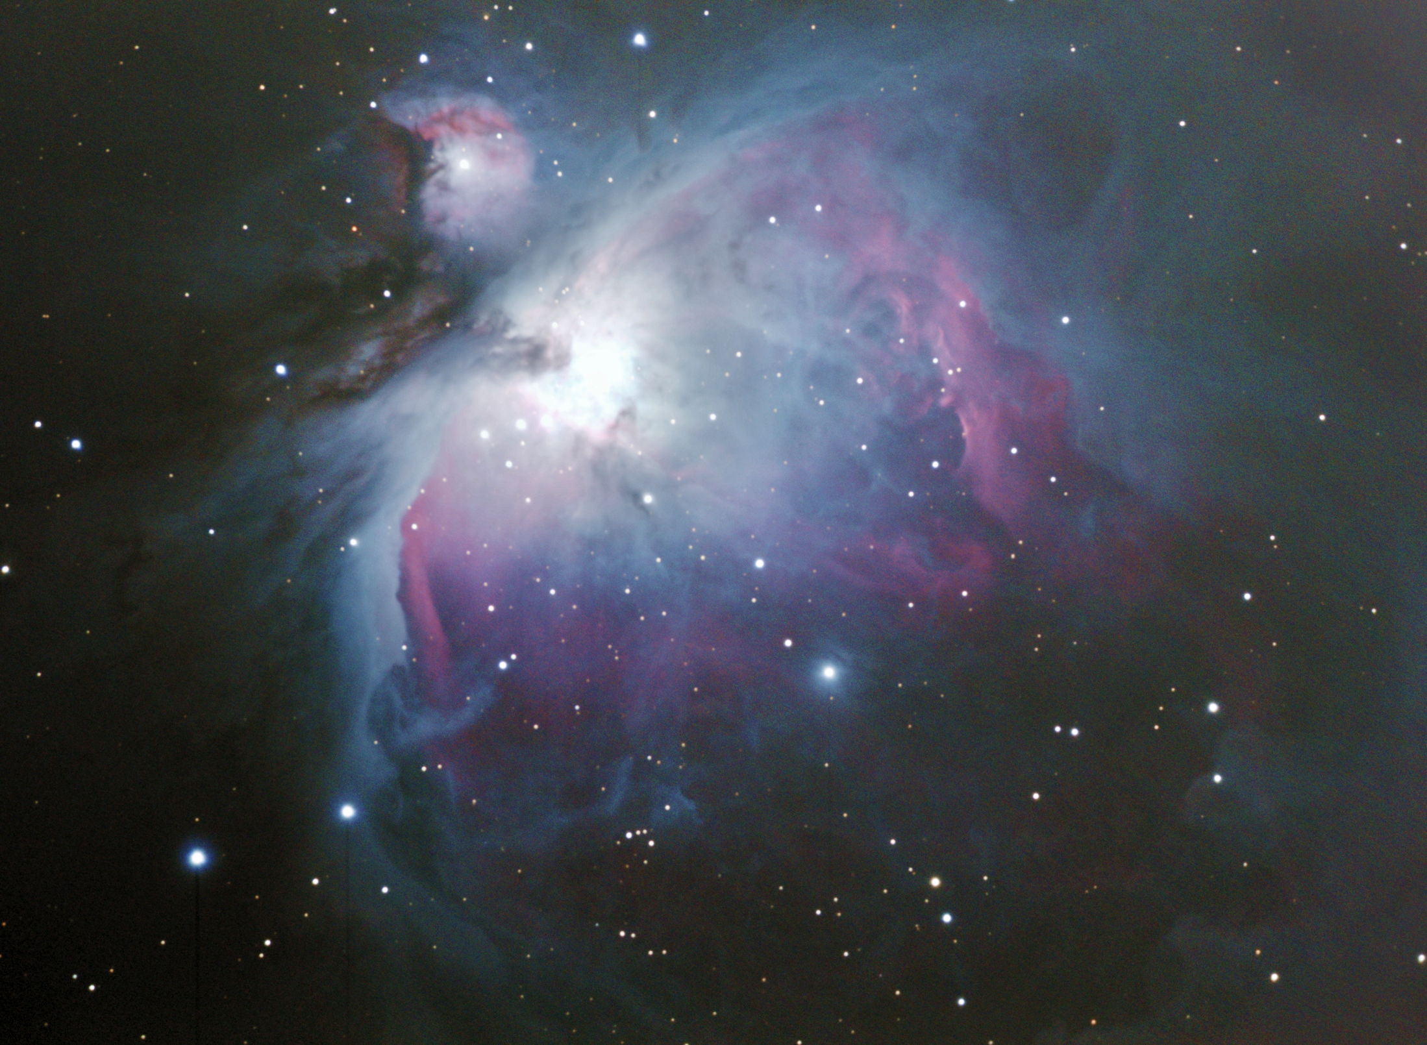
Mike Krauss

Slide 22
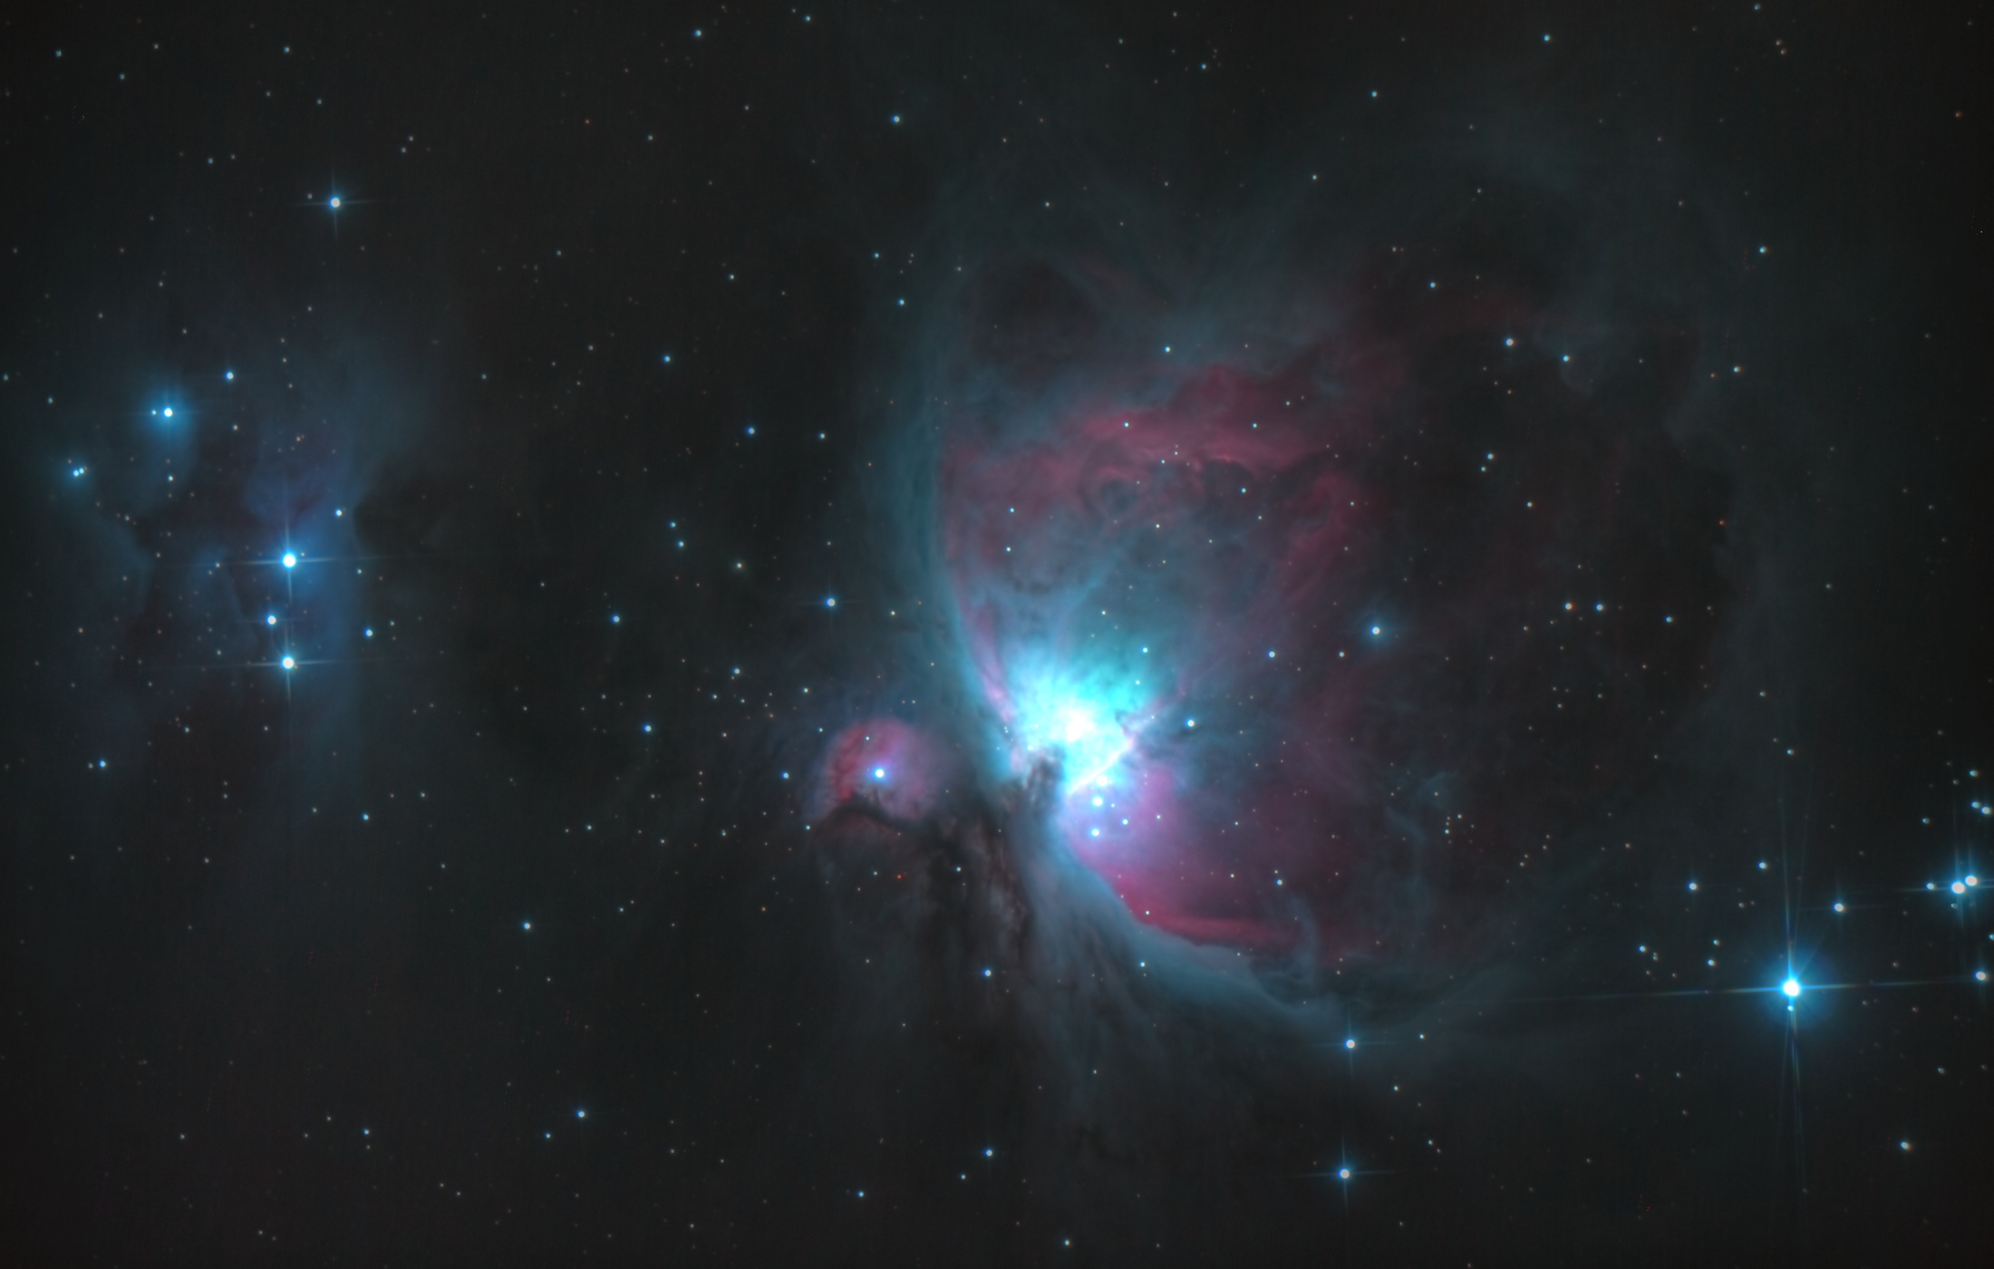
Carson O’Ffill

Slide 23
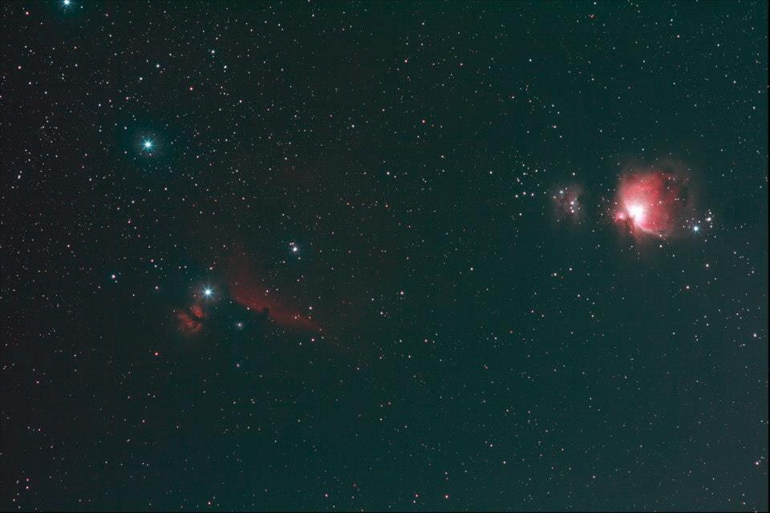
Joe Bohanon

Slide 24
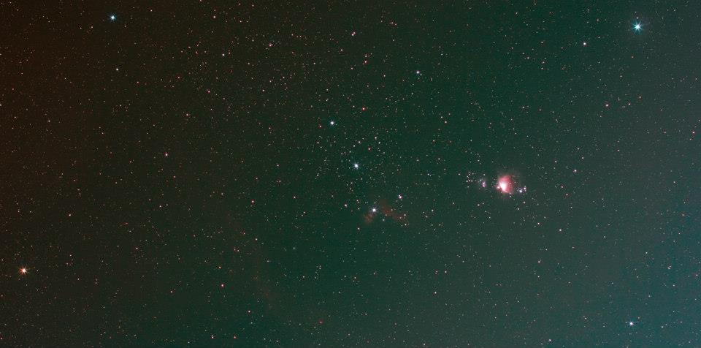
Joe Bohanon

Slide 25
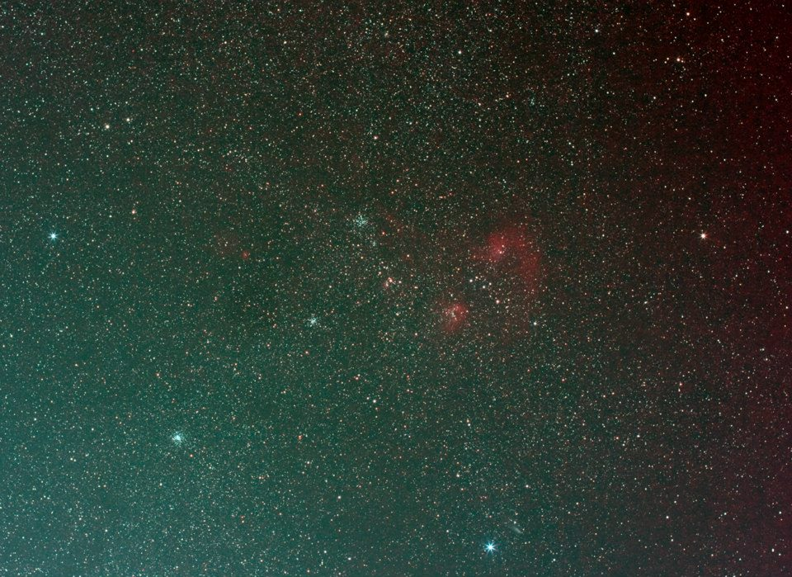
Joe Bohanon

Slide 26
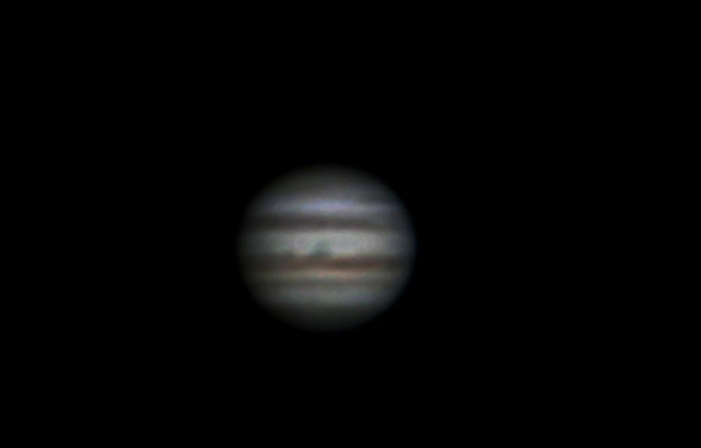
Joe Bohanon

Slide 27
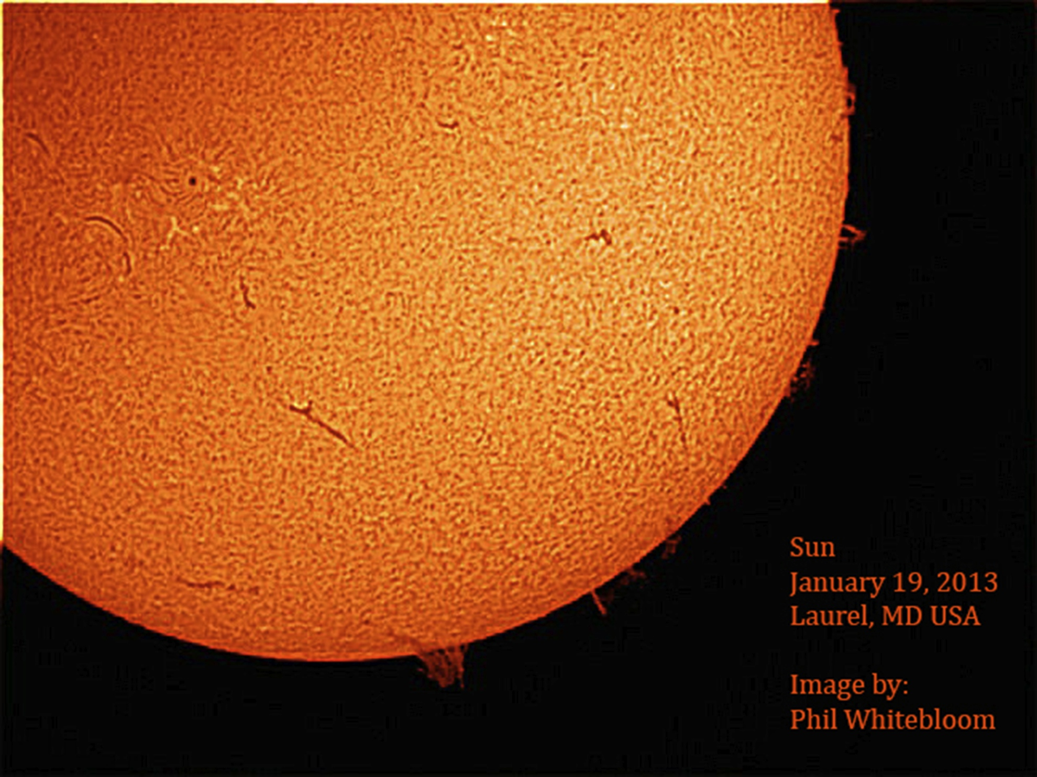

Slide 28
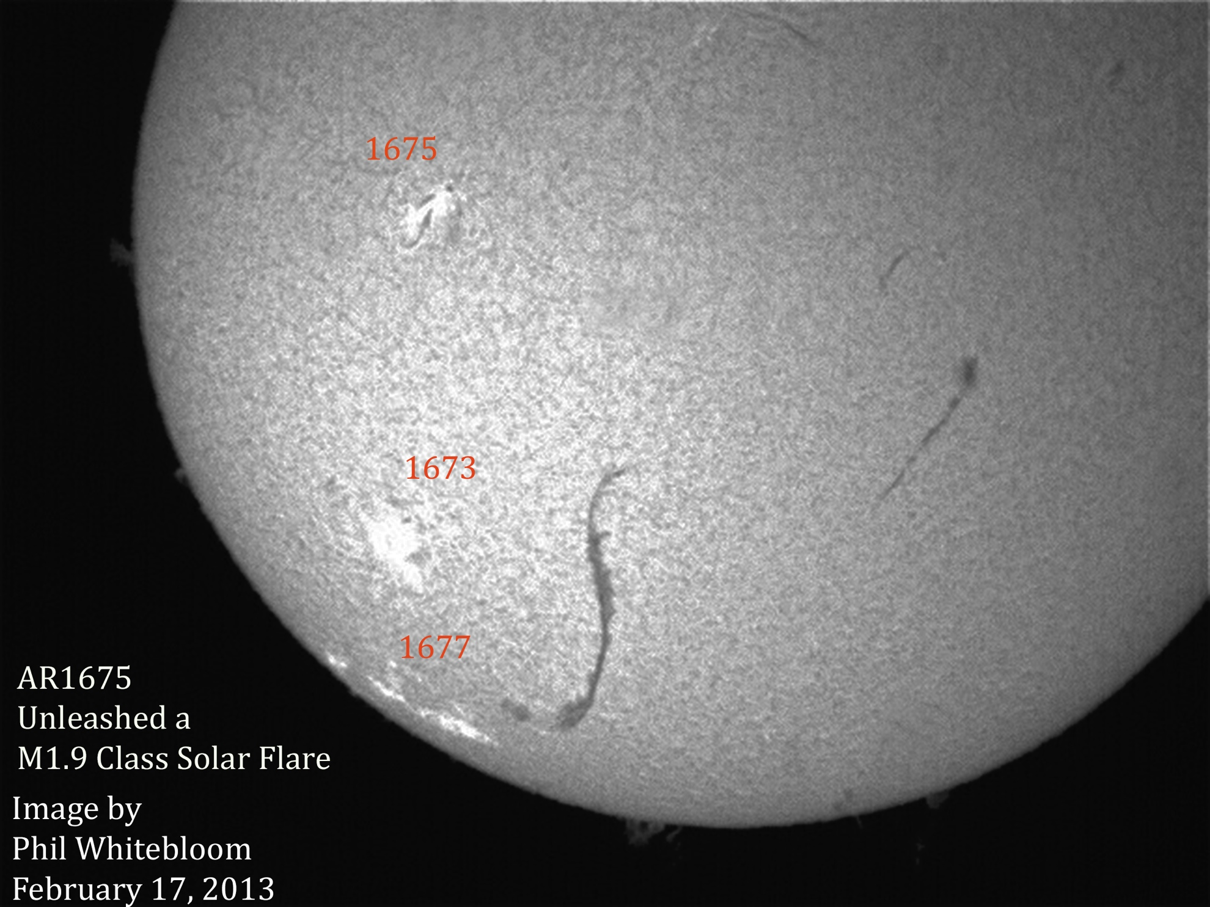

Slide 29
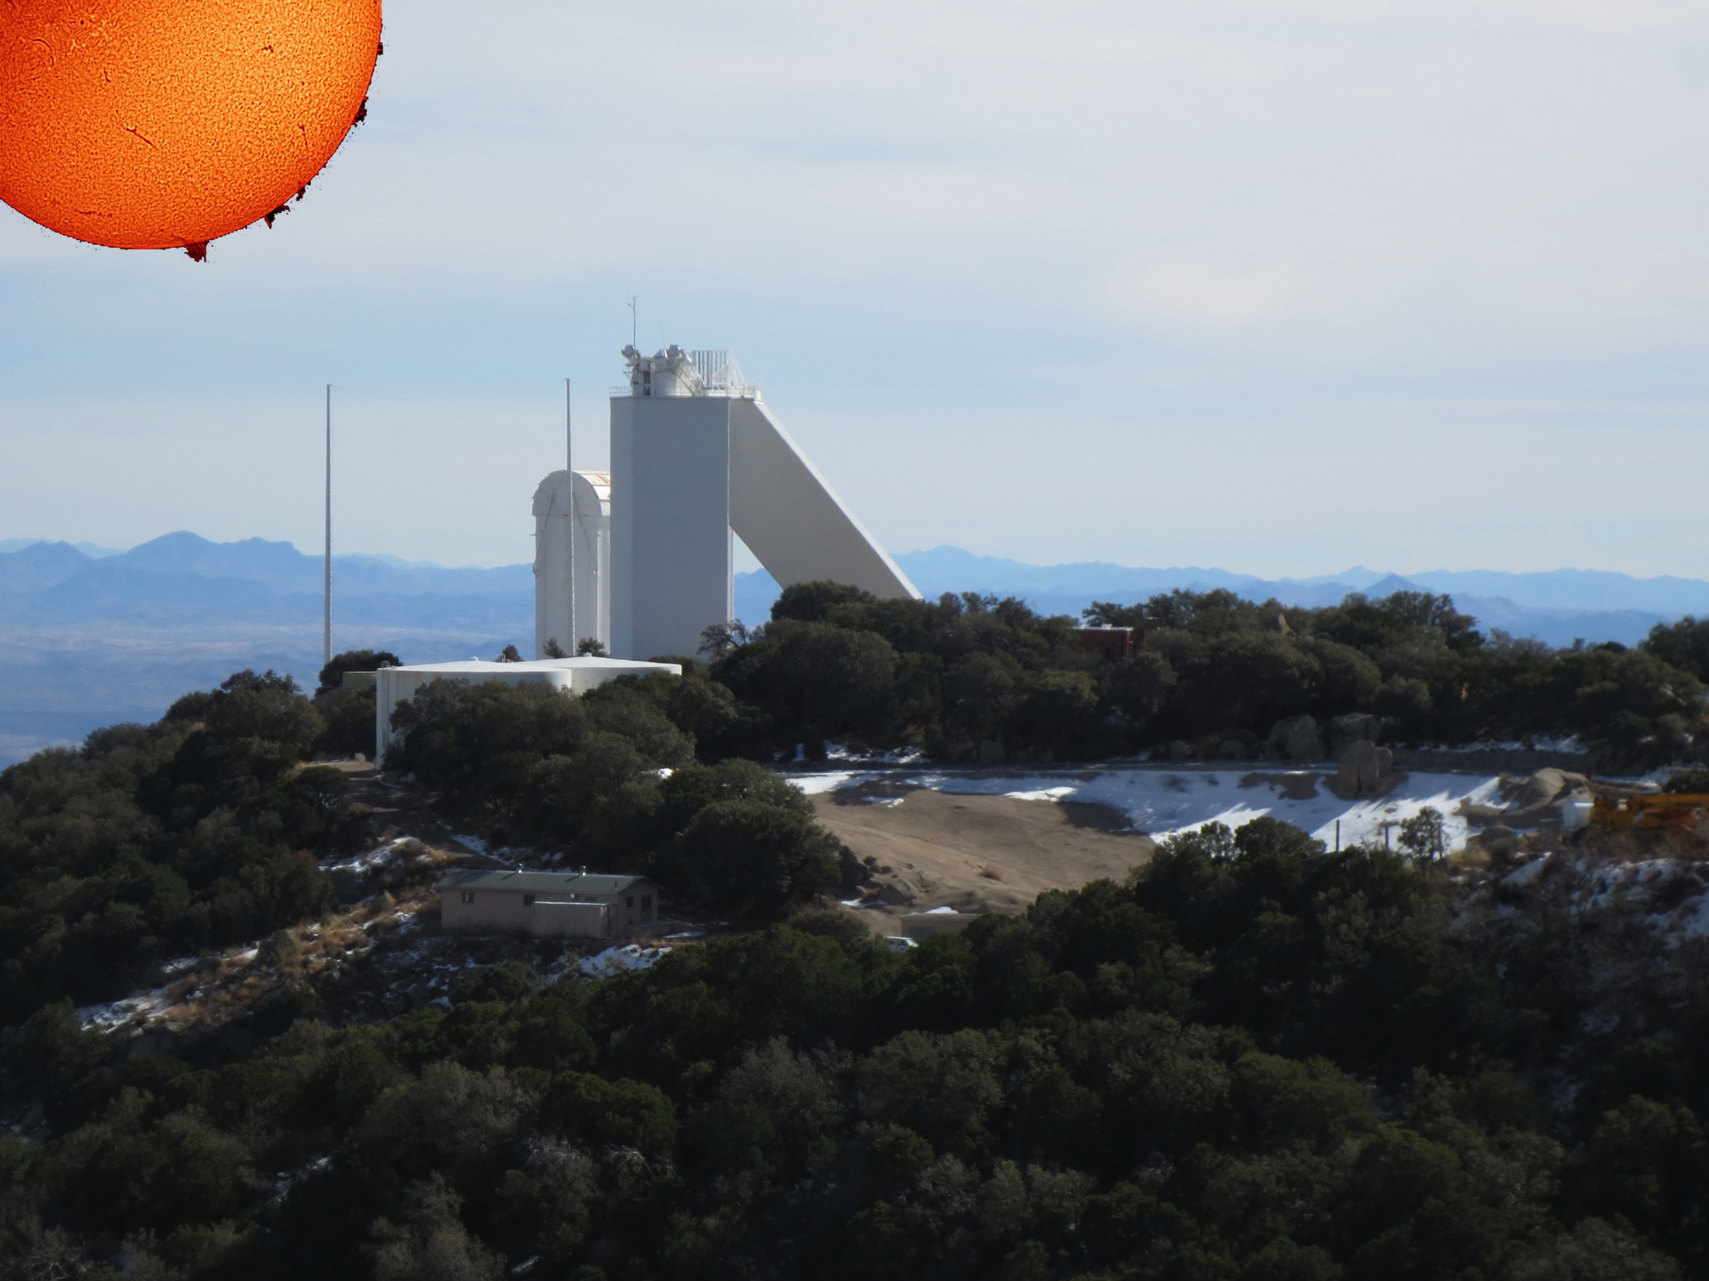
Philip Whitebloom

Slide 30
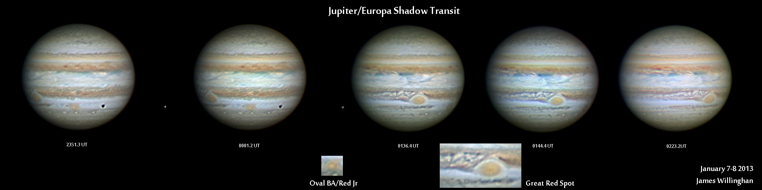
James Willinghan

Slide 31
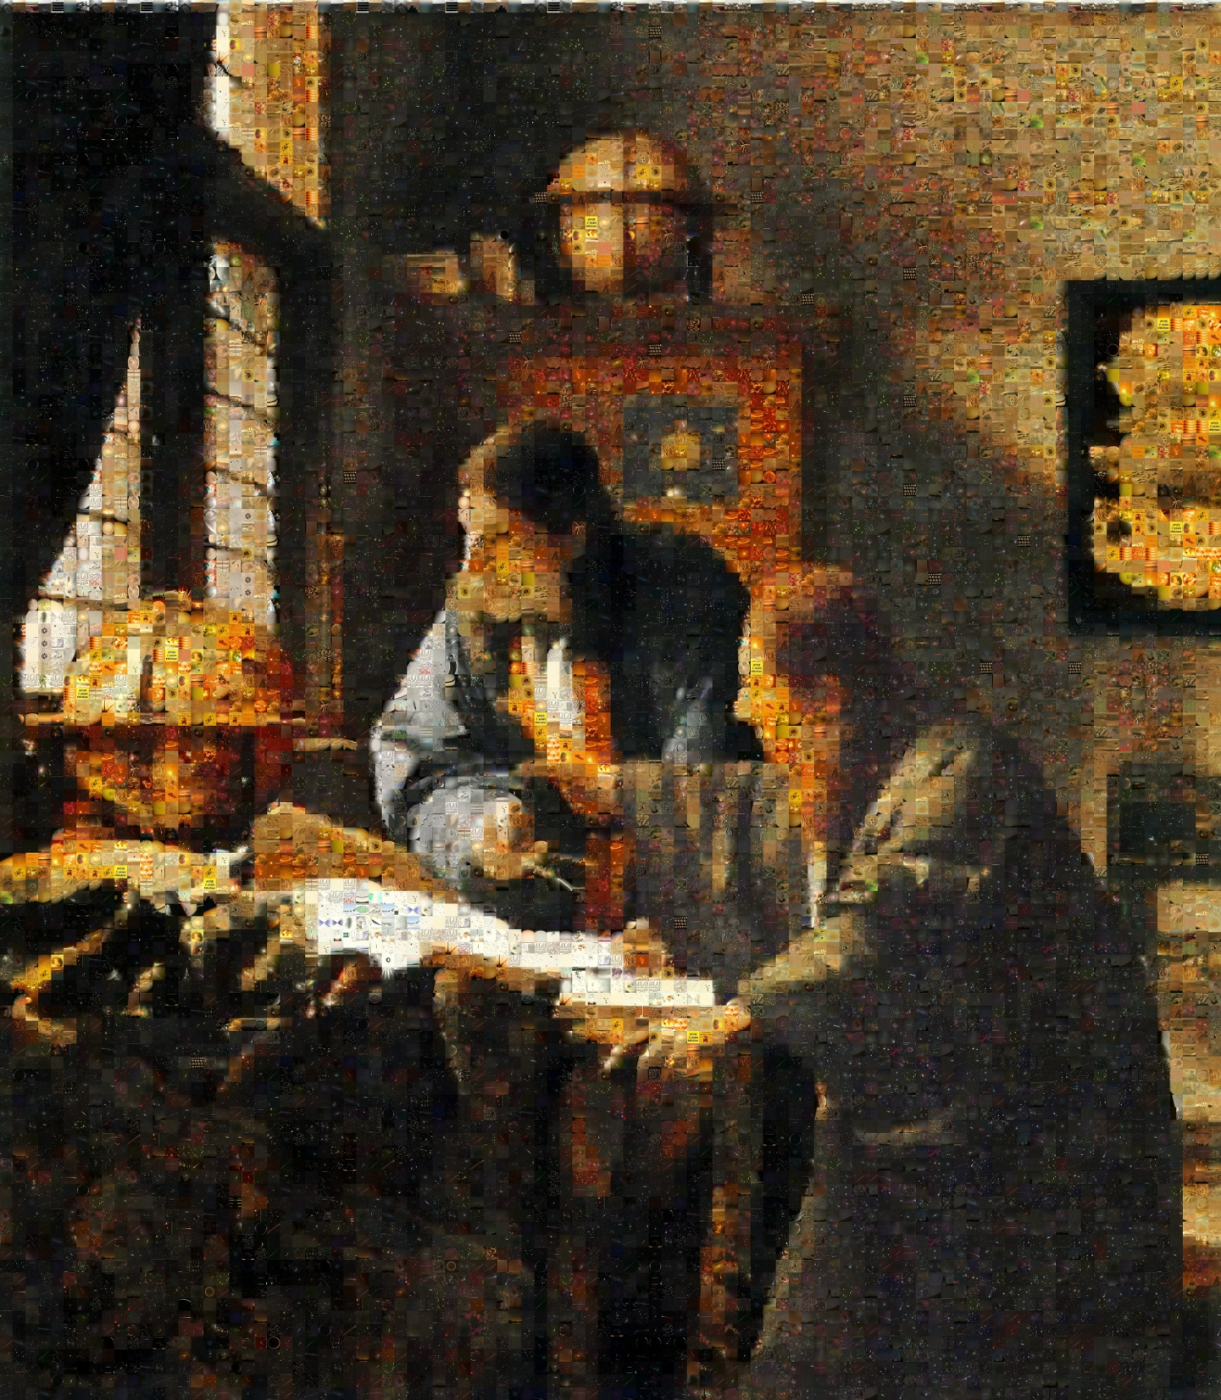
Dr. Jerry Bonnell Astronomy Picture of the Day

Slide 32
Stumper answer

Slide 33
Which constellation has the greatest area?
Auriga – 657.438 sq. deg.
Gemini – 513.761 sq. deg
Orion – 594.120 sq. deg
D. Taurus – 797.249 sq. deg
Notes:
Need to find a references on the web for the area in square degrees of these constellations, and maybe include a chart with the constellation borders

Slide 34
Thank You!
Next month’s meeting is on Thursday,
March 21, 2013
7:30 PM
Guest speaker:
Mark “Indy” Kochte
Time-lapse photography

